Slide 1



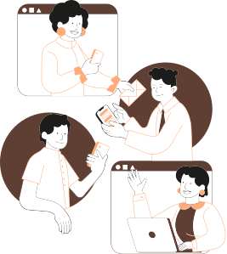

TEAM COLLABORATION I
Fullstack Web Development batch 15
Team Code Breakers

Slide 2

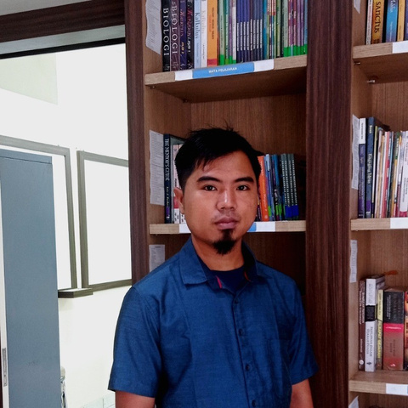
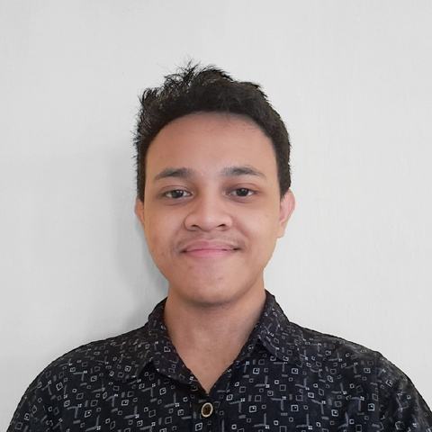
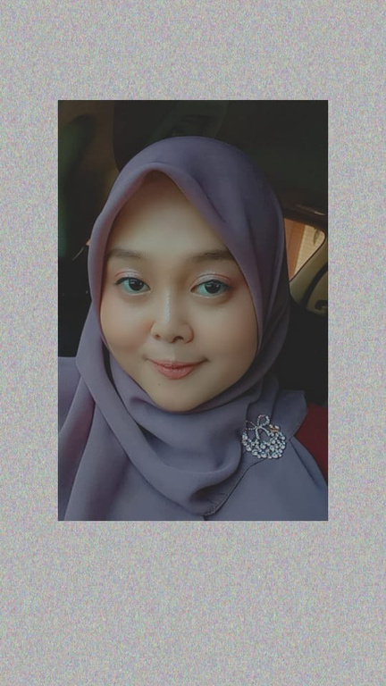

Meet Our Team
Hendri
Itmamul Fahmi
Pingkan P. Arianto
Ketua Kelompok
Wakil Ketua
Anggota 1
Front-End
Front-End
Front-End

Slide 3


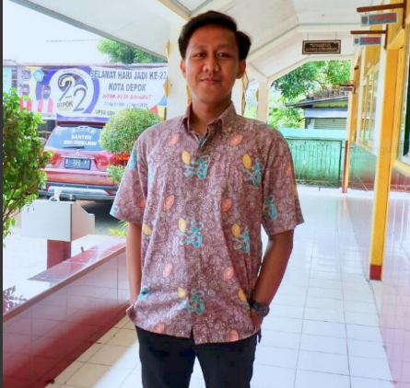
Meet Our Team
Amat Amin Daus
Putu Bagus R.
Luthfi Putra M.
Anggota 2
Anggota 3
Anggota 4
Back-End
Back-End
Back-End

Slide 4



About Project
An online news app with a wealth of information. Become a writer and share your perspective with the world. Don't be afraid to reveal the facts.

Slide 5



Built In Front-End
React JS
Tailwind CSS
DaisyUI
Javascript Library
Framework CSS
Framework CSS

Slide 6


Built In Front-End
Axios
Formik
Moment JS.
a simple promise based HTTP client for the browser and node.js
to help developers learn to better interact with the date and time
to build simple and complex forms in React

Slide 7


Built In Back-End
Argon
Node JS.
Express JS.
for password hash
is a back-end JavaScript runtime environment
is a minimal and flexible Node.js web application framework

Slide 8
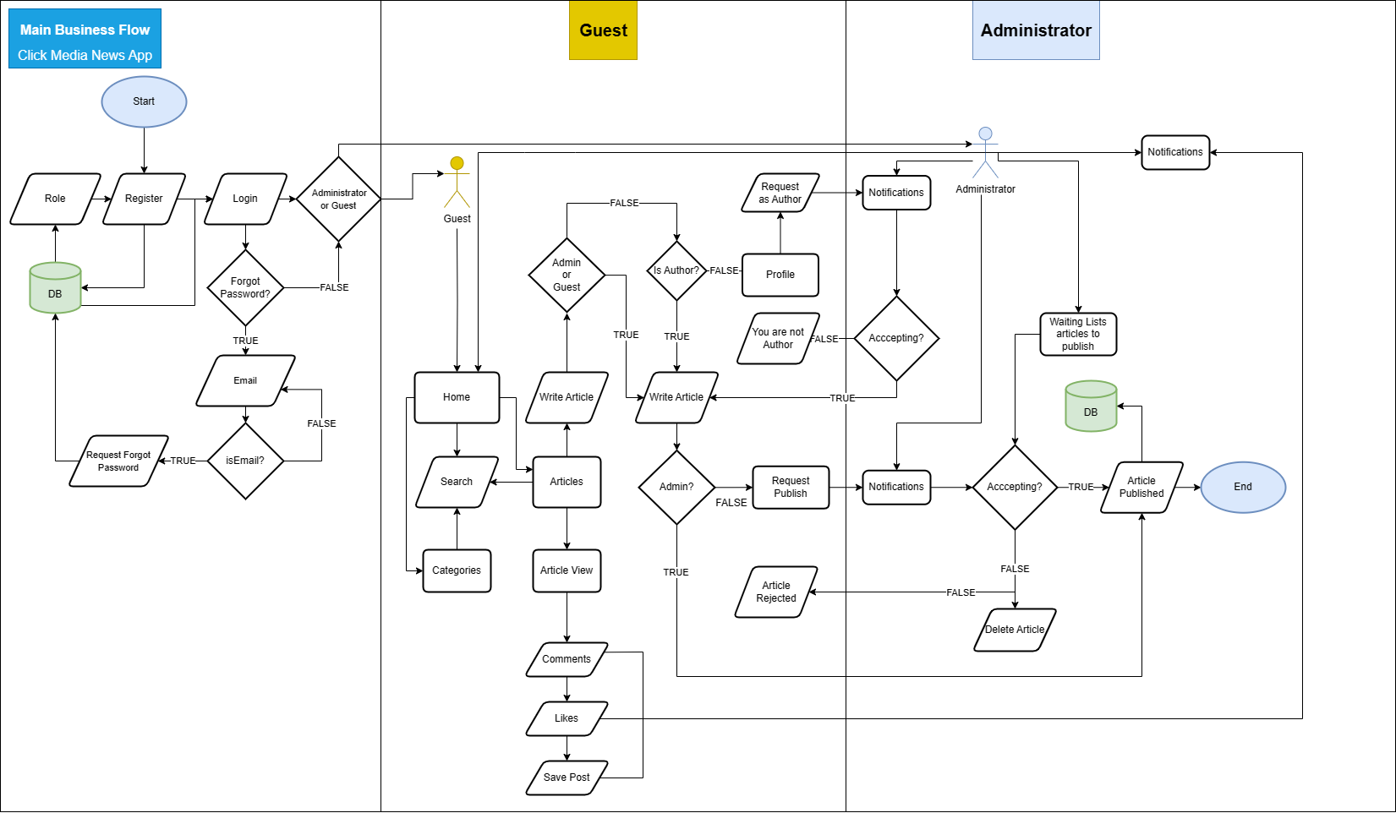

Slide 9
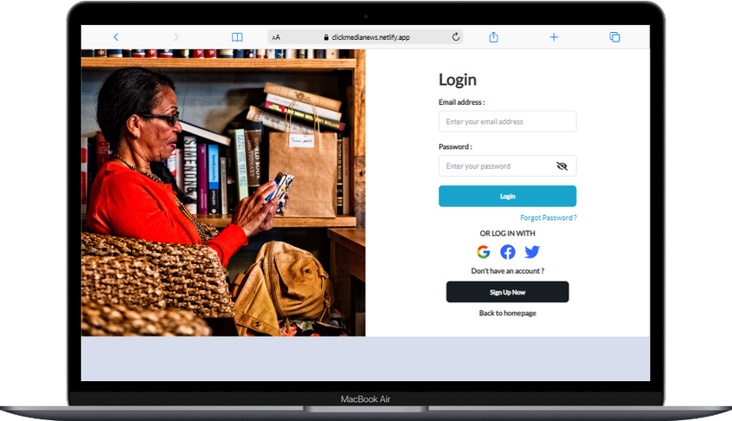
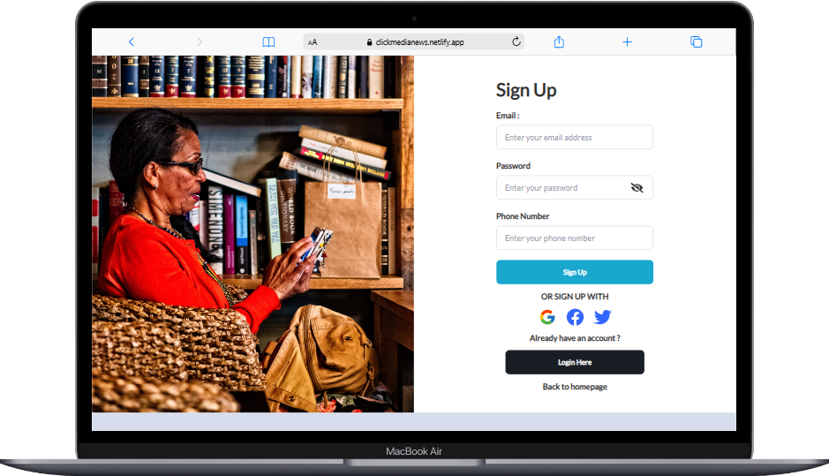
Sign In
Sign Up

Slide 10

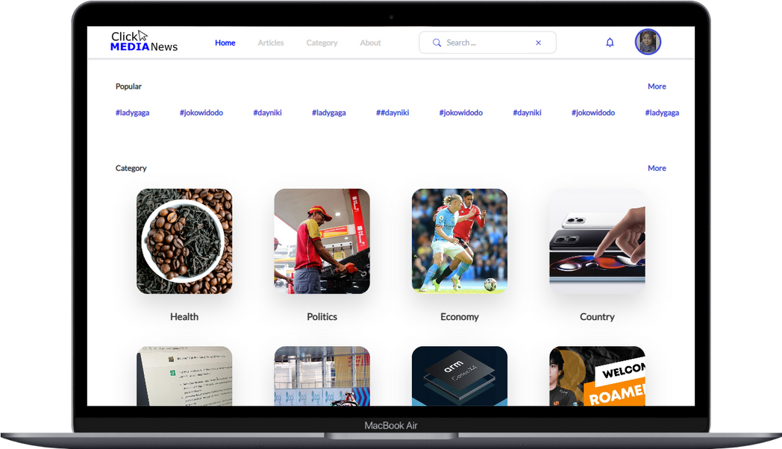
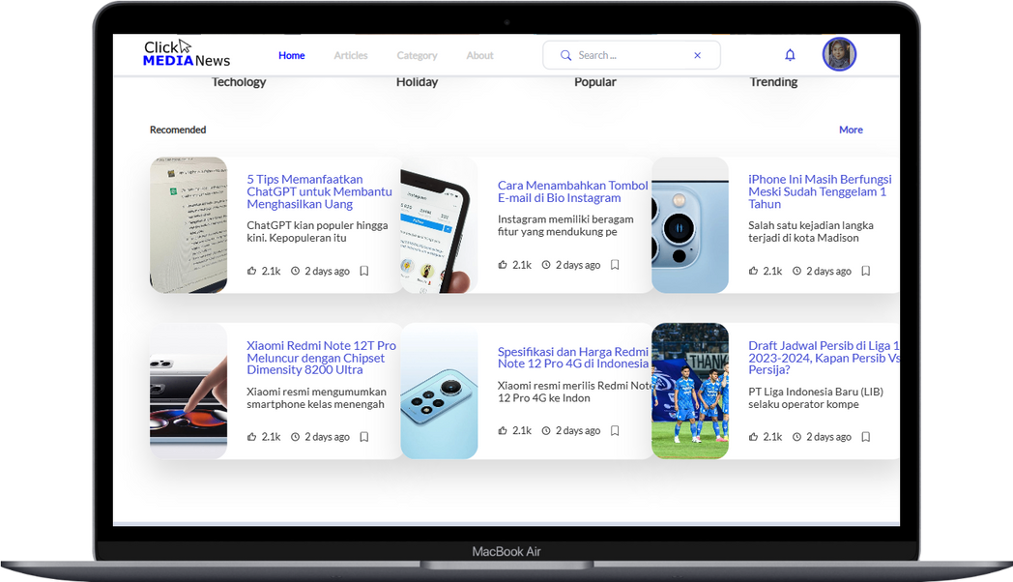
Homepage

Slide 11
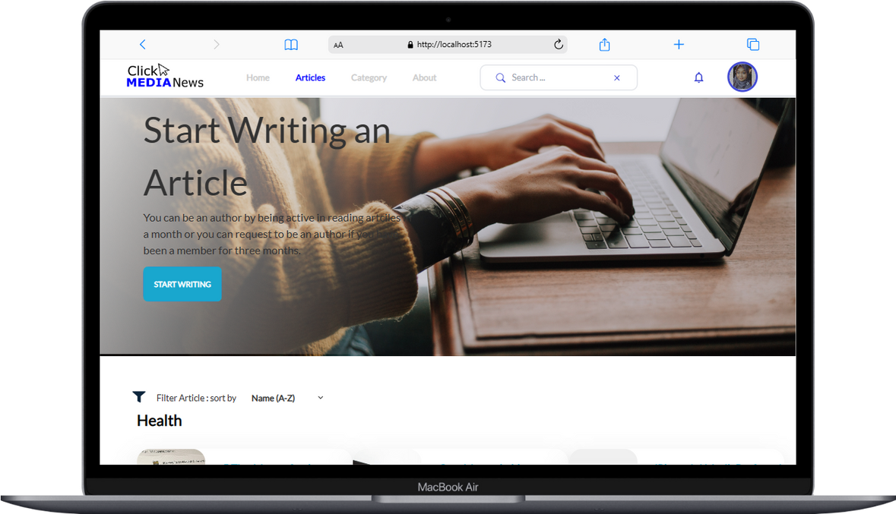
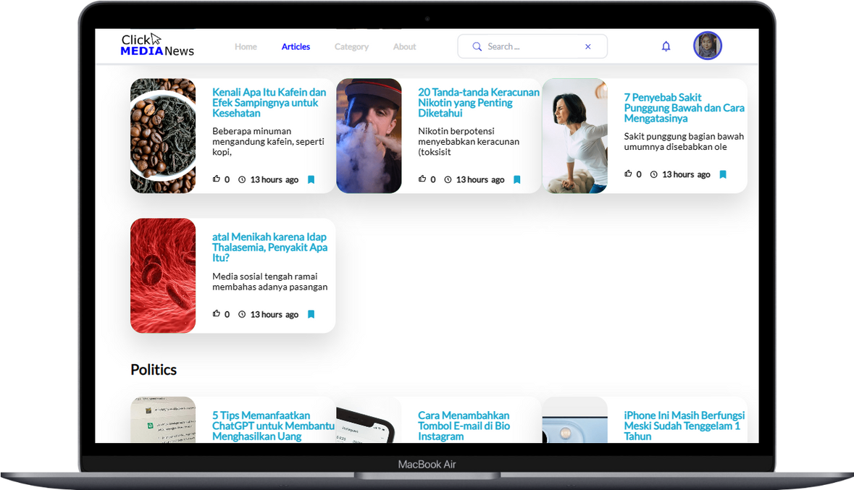
Articles

Slide 12
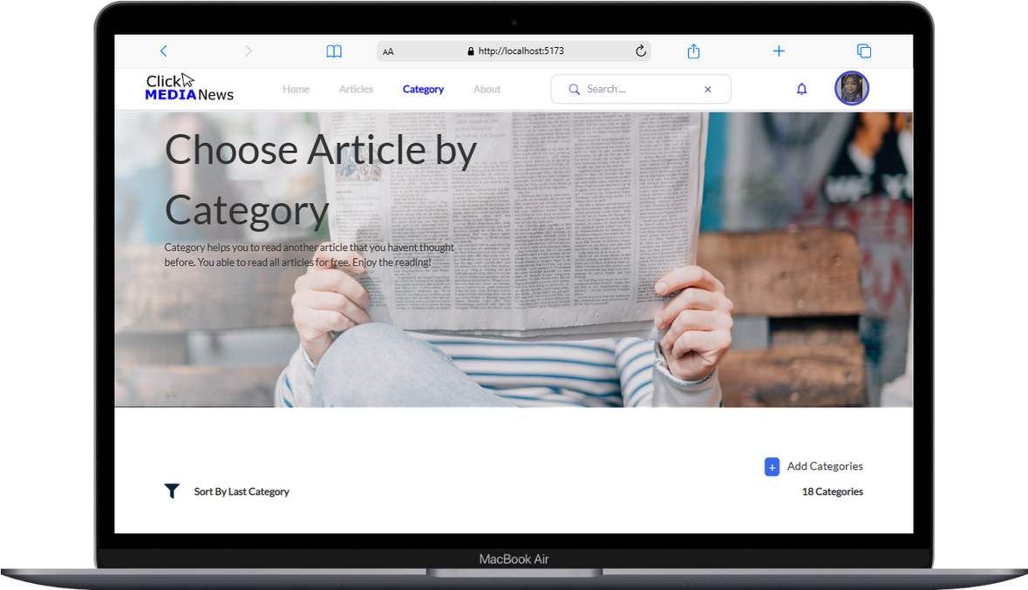
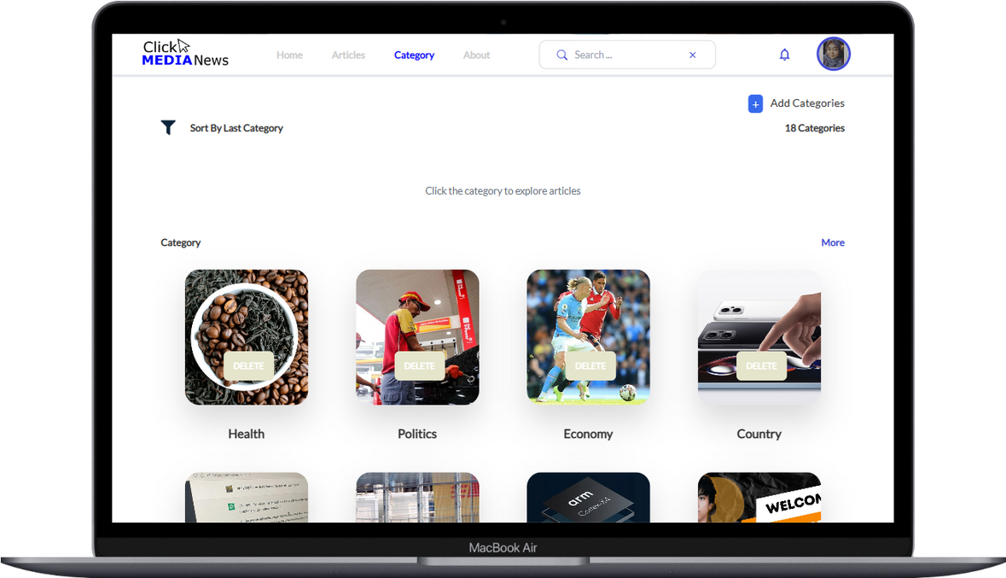
Category

Slide 13
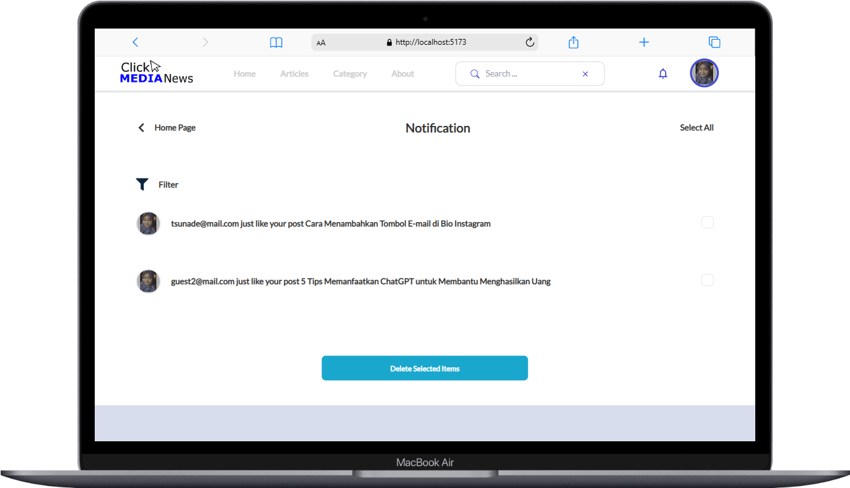
Notification

Slide 14
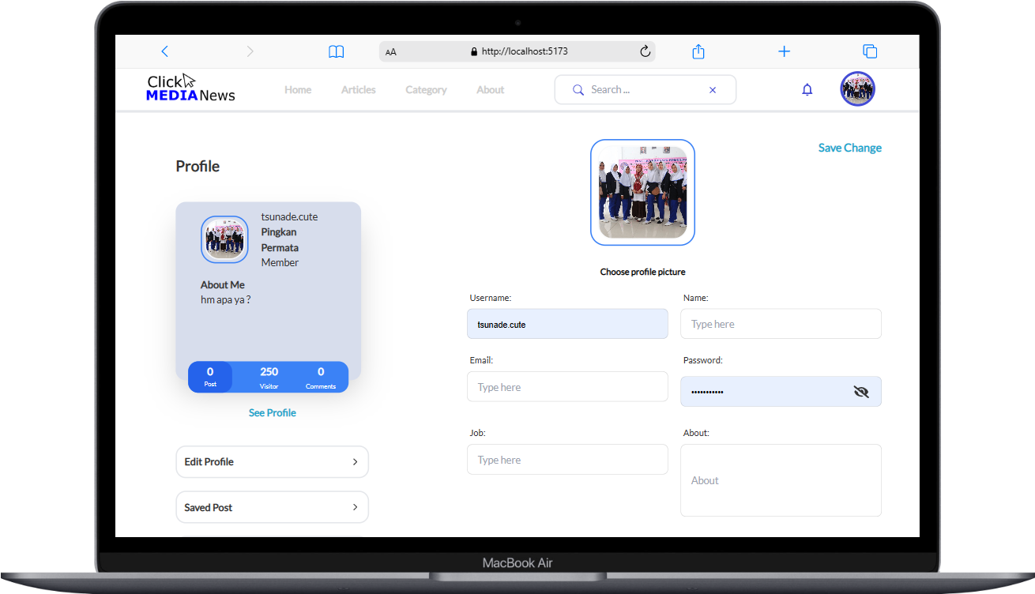
Edit Profile

Slide 15
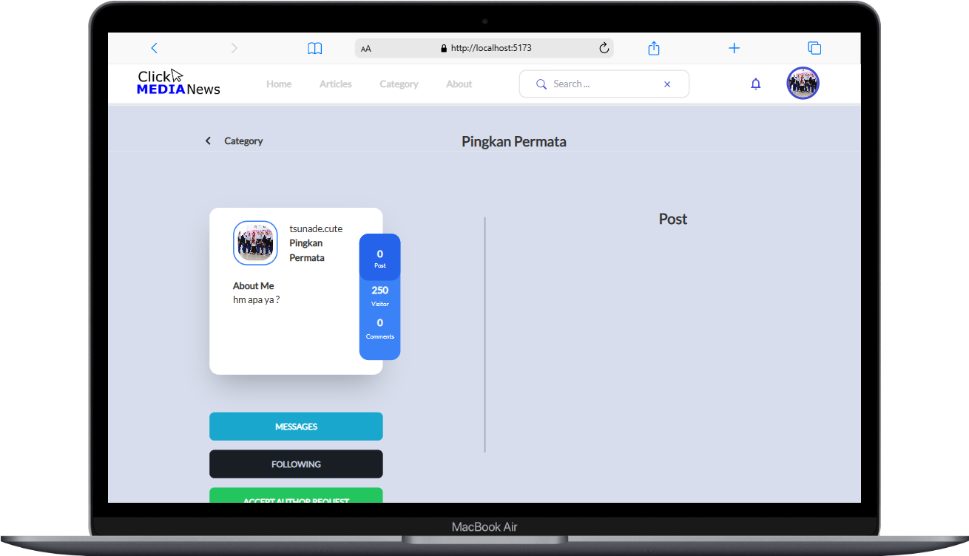
Profile

Slide 16

Anyone want to ask ??

Slide 17

Hendri | Fahmi | Pingkan
Luthfi | Putu | Daus
Thankyou !
Team Code Breakers | Team Collaboration I

